Slide 1


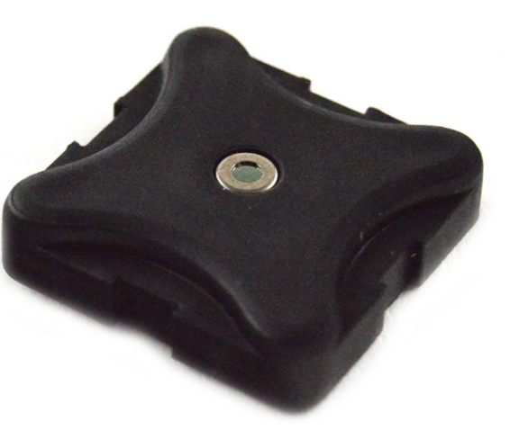
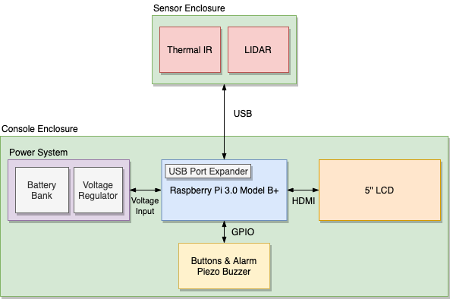
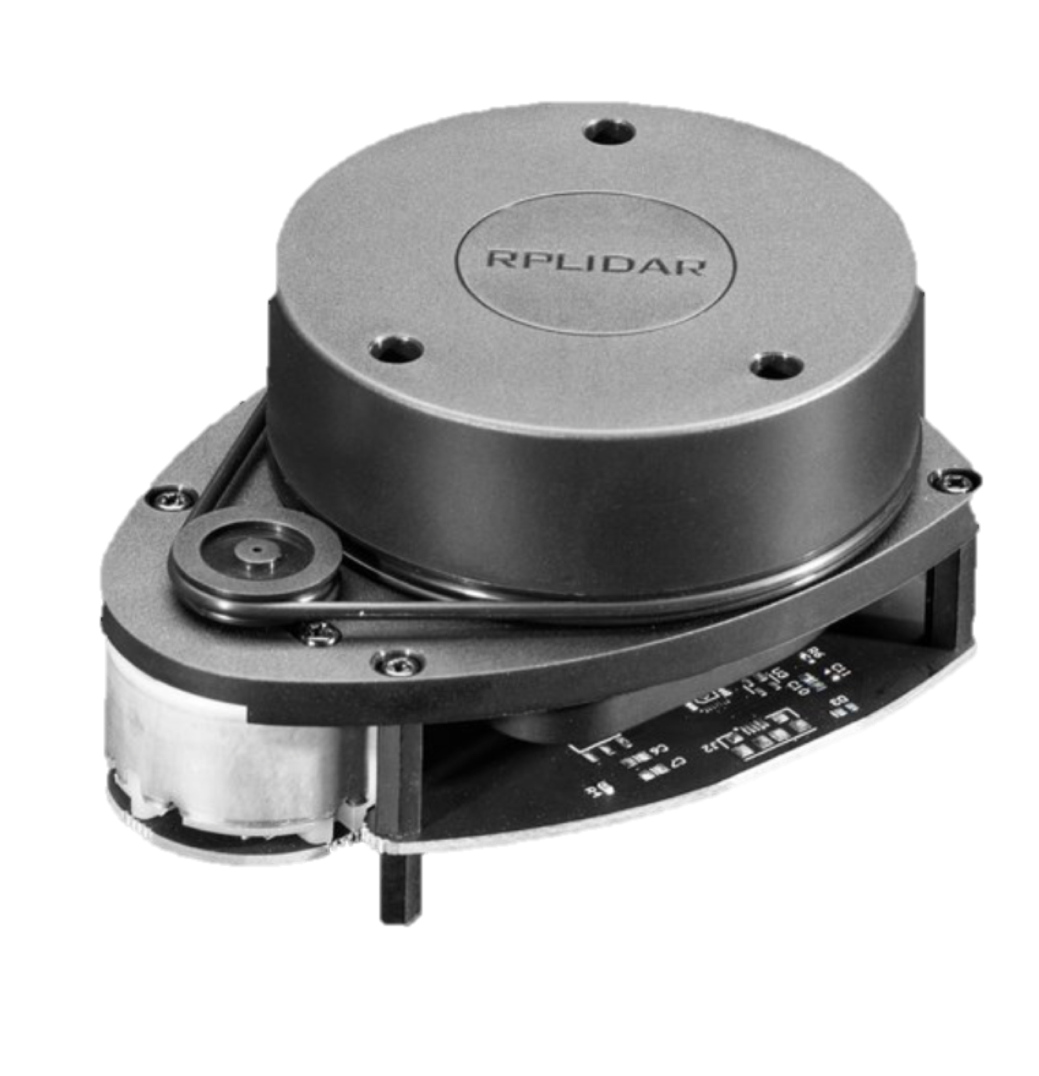
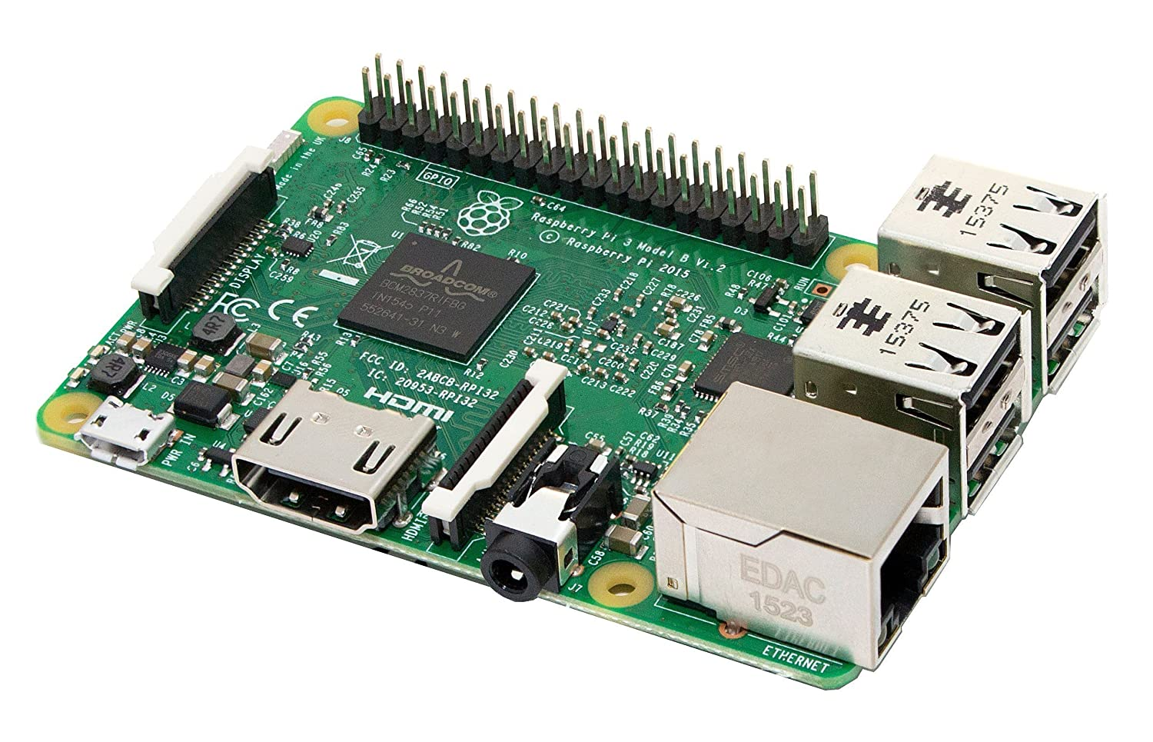
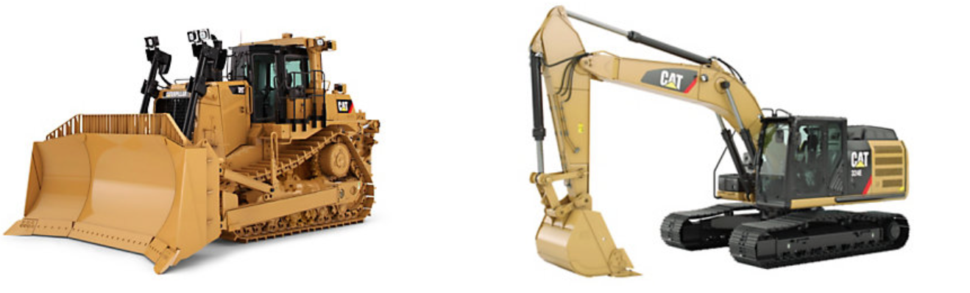
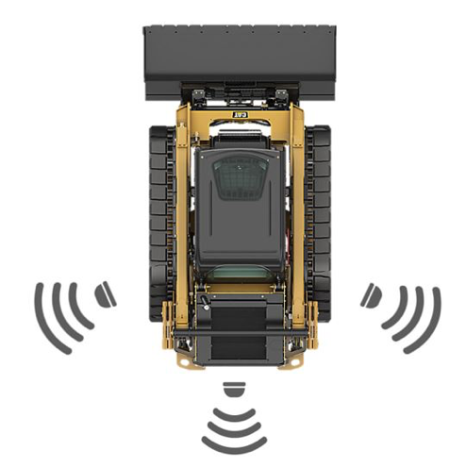

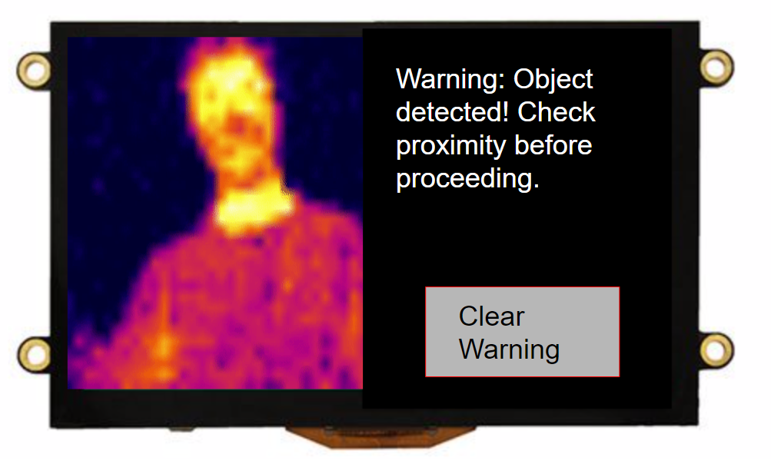
Caterpillar Proximity Detection System
Mentor: Joel Willis, Jay Johnson Team: Andy Dinh, Tyler Edwards, Kara Jin, Devin Stafford Instructor: Bobby Compton
Develop and integrate an object detection system which will alert machine operators when in close proximity of other construction machinery and nearby personnel
Technologies
Problem Statement
System Design
IR Thermal Sensor
LIDAR Sensor
Raspberry Pi
User Interface
Detect personnel and objects within a 5 meter radius
Differentiate between personnel and inanimate objects
Provide 360° coverage of machine
Provide remote alerts to the operator via user interface
Key Product Requirements
Developed an algorithm that combines Thermal IR & LIDAR data to detect humans
Simultaneously display several Thermal IR images
Created custom GUI for operator to be notified of warnings and view thermal live video
Constructed custom sensor and console enclosures CAD files
Design Milestones
Next Steps
Refine human detection algorithm for noise interference and varying weather/light conditions
Create custom PCB for system
Update custom enclosures to be more waterproof and durable

